Slide 1
Software Quality
1

Slide 2
Software Quality
Software Quality
Different people understand different meanings of quality like:
conformance to requirements
fitness for the purpose
level of satisfaction

Slide 3
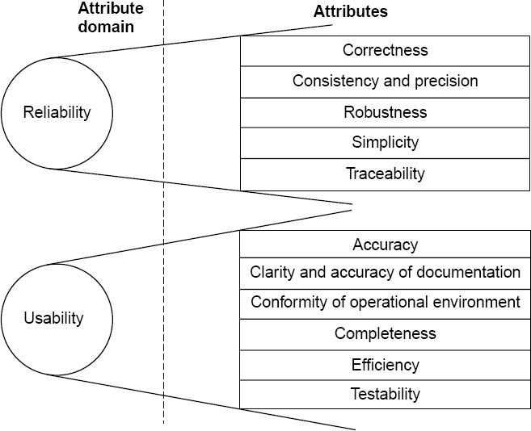
Software Quality

Slide 4
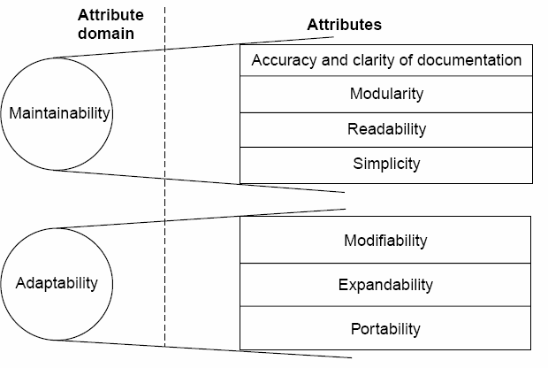
Software Quality

Slide 5
Software Quality
1 | Reliability | The extent to which a software performs its intended functions without failure.
2 | Correctness | The extent to which a software meets its specifications.
3 | Consistency & precision | The extent to which a software is consistent and give results with precision.
4 | Robustness | The extent to which a software tolerates the unexpected problems.
5 | Simplicity | The extent to which a software is simple in its operations.
6 | Traceability | The extent to which an error is traceable in order to fix it.
7 | Usability | The extent of effort required to learn, operate and understand the functions of the software

Slide 6
Software Quality
8 | Accuracy | Meeting specifications with precision.
9 | Clarity & Accuracy of documentation | The extent to which documents are clearly & accurately written.
10 | Conformity of operational environment | The extent to which a software is in conformity of operational environment.
11 | Completeness | The extent to which a software has specified functions.
12 | Efficiency | The amount of computing resources and code required by software to perform a function.
13 | Testability | The effort required to test a software to ensure that it performs its intended functions.
14 | Maintainability | The effort required to locate and fix an error during maintenance phase.

Slide 7
Software Quality
15 | Modularity | It is the extent of ease to implement, test, debug and maintain the software.
16 | Readability | The extent to which a software is readable in order to understand.
17 | Adaptability | The extent to which a software is adaptable to new platforms & technologies.
18 | Modifiability | The effort required to modify a software during maintenance phase.
19 | Expandability | The extent to which a software is expandable without undesirable side effects.
20 | Portability | The effort required to transfer a program from one platform to another platform.
Table :Software quality attributes

Slide 8
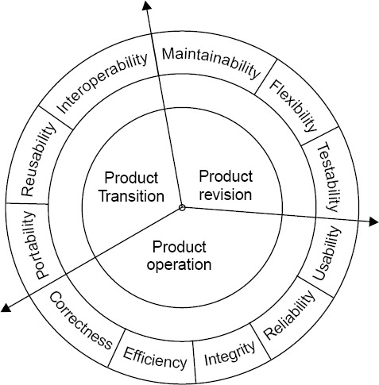
Software Quality
McCall Software Quality Model
Fig : Software quality factors

Slide 9
Software Quality
i. Product Operation
Factors which are related
to the operation
of a product are
combined. The factors are:
Correctness
Efficiency
Integrity
Reliability
Usability
These five factors are related to operational performance, convenience, ease of usage and its correctness. These factors play a very significant role in building customer’s satisfaction.

Slide 10
Software Quality
ii. Product Revision
The factors which are required combined and are given below:
for testing
& maintenance are
Maintainability
Flexibility
Testability
These factors pertain to the testing & maintainability of software. They give us idea about ease of maintenance, flexibility and testing effort. Hence, they are combined under the umbrella of product revision.

Slide 11
Software Quality
Product Transition
We may have to transfer a product from one platform to an other platform or from one technology to another technology. The factors related to such a transfer are combined and given below:
Portability
Reusability
Interoperability

Slide 12
Software Quality
Most of the quality factors are explained. The remaining factors are :
Sr.No. | Quality Factors | Purpose
1 | Integrity | The extent to which access to software or data by the unauthorized persons can be controlled.
2 | Flexibility | The effort required to modify an operational program.
3 | Reusability | The extent to which a program can be reused in other applications.
4 | Interoperability | The effort required to couple one system with another.
Table : Remaining quality factors

Slide 13
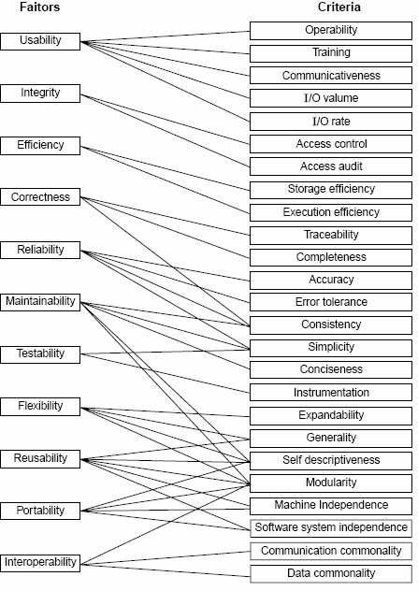
Quality criteria
Fig : McCall’s quality model

Slide 14
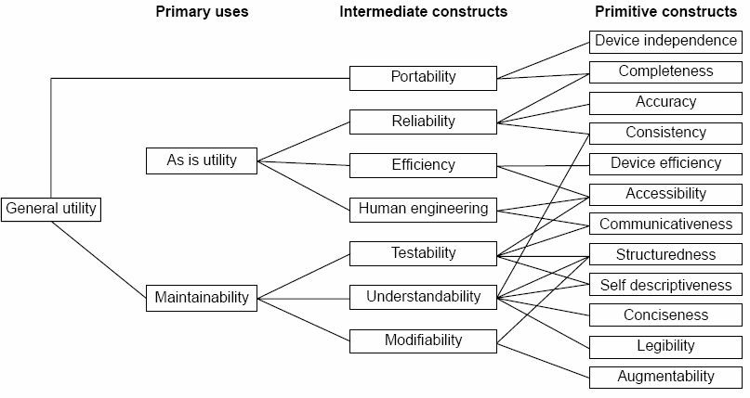
Software Quality
Boehm Software Quality Model
Fig. : The Boehm software quality model

Slide 15
Software Quality
ISO 9126
Functionality
Reliability
Usability
Efficiency
Maintainability
Portability

Slide 16

Software Quality
Characteristic/ Attribute | Short Description of the Characteristics and the concerns Addressed by Attributes
Functionality | Characteristics relating to achievement of the basic purpose for which the software is being engineered
Suitability | The presence and appropriateness of a set of functions for specified tasks
Accuracy | The provision of right or agreed results or effects
Interoperability | Software’s ability to interact with specified systems
Security | Ability to prevent unauthorized access, whether accidental or deliberate, to program and data.
Reliability | Characteristics relating to capability of software to maintain its level of performance under stated conditions for a stated period of time
Maturity | Attributes of software that bear on the frequency of failure by faults in the software

Slide 17
Software Quality
Fault tolerance | Ability to maintain a specified level of performance in cases of software faults or unexpected inputs
Recoverability | Capability and effort needed to reestablish level of performance and recover affected data after possible failure.
Usability | Characteristics relating to the effort needed for use, and on the individual assessment of such use, by a stated implied set of users.
Understandability | The effort required for a user to recognize the logical concept and its applicability.
Learnability | The effort required for a user to learn its application, operation, input and output.
Operability | The ease of operation and control by users.
Efficiency | Characteristic related to the relationship between the level of performance of the software and the amount of resources used, under stated conditions.

Slide 18
Software Quality
Time behavior | The speed of response and processing times and throughout rates in performing its function.
Resource behavior | The amount of resources used and the duration of such use in performing its function.
Maintainability | Characteristics related to the effort needed to make modifications, including corrections, improvements or adaptation of software to changes in environment, requirements and functions specifications.
Analyzability | The effort needed for diagnosis of deficiencies or causes of failures, or for identification of parts to be modified.
Changeability | The effort needed for modification, fault removal or for environmental change.
Stability | The risk of unexpected effect of modifications.
Testability | The effort needed for validating the modified software.

Slide 19
Software Quality
Portability | Characteristics related to the ability to transfer the software from one organization or hardware or software environment to another.
Adaptability | The opportunity for its adaptation to different specified environments.
Installability | The effort needed to install the software in a specified environment.
Conformance | The extent to which it adheres to standards or conventions relating to portability.
Replaceability | The opportunity and effort of using it in the place of other software in a particular environment.
Table : Software quality characteristics and attributes – The ISO 9126 view

Slide 20
Thank you

